Slide 1
L17. Reinforcement Learning
(Extensions)

Slide 2
L17. Reinforcement Learning
(Extensions)
1. One step→ Multiple steps ahead (links to Monte Carlo)
2. Model-free→ Include the model of environment (links to Dynamic programming)
3. Tabular → Continuous space (links to supervised learning)
4. Single agent → Multiple Agents (links to Game theory: Stochastic Game)

Slide 3
Dynamic Programming
Monte Carlo Control
+
Temporal Difference Control
1. One step→ Multiple steps ahead (links to Monte Carlo)
2. Model-free→ Include the model of environment (links to Dynamic programming)
3. Tabular → Continuous space (links to supervised learning)
4. Single agent → Multiple Agents (links to Game theory: Stochastic Game)

Slide 4
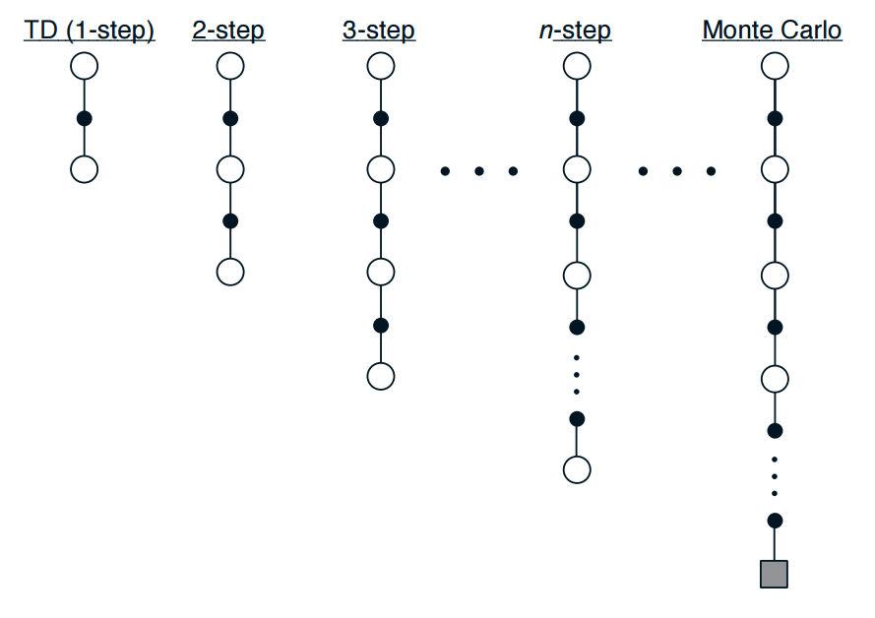

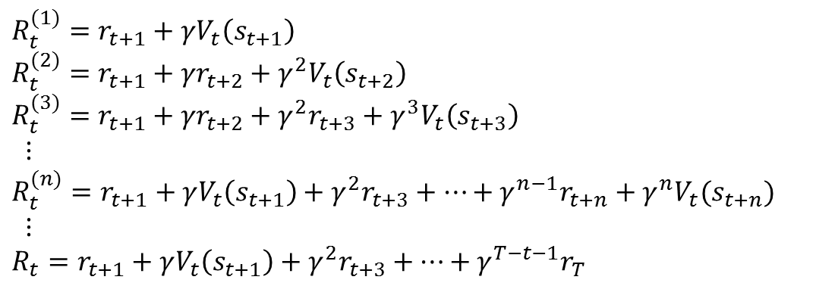
n-Steps TD Prediction
TD method
$$R_{t}^{(1)}=r_{t+1}+γV_{t}\left(s_{t+1}\right)$$
$$R_{t}^{(2)}=r_{t+1}+{γr}_{t+2}+γ^{2}V_{t}\left(s_{t+2}\right)$$
$$R_{t}^{(3)}=r_{t+1}+{γr}_{t+2}+{γ^{2}r}_{t+3}+γ^{3}V_{t}\left(s_{t+3}\right)$$
$$⋮$$
$$R_{t}^{(n)}=r_{t+1}+γV_{t}\left(s_{t+1}\right)+{γ^{2}r}_{t+3}+…+γ^{n−1}r_{t+n}+γ^{n}V_{t}(s_{t+n})$$
$$⋮$$
$$R_{t}=r_{t+1}+γV_{t}\left(s_{t+1}\right)+{γ^{2}r}_{t+3}+…+γ^{T−t−1}r_{T}$$
Monte Carlo method
$$ΔV_{t}\left(s_{t}\right)←V_{t}\left(s_{t}\right)+α\left[R_{t}^{(n)}−V_{t}(s_{t})\right]$$

Slide 5
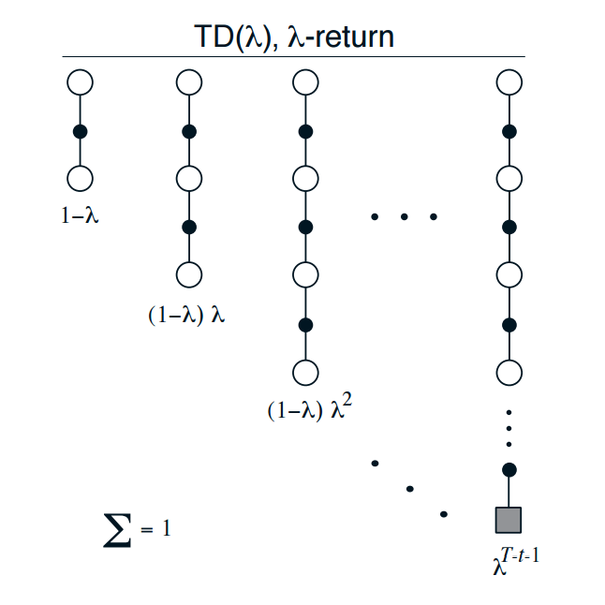



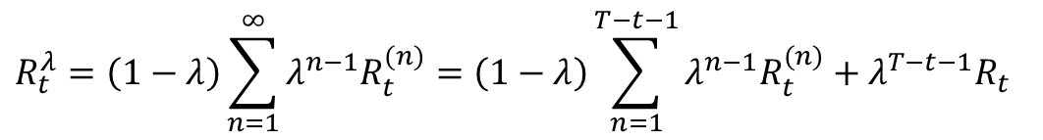
TD$(λ)$ Method
$$R_{t}^{λ}=\left(1−λ\right)\sum_{n=1}^{∞}{λ^{n−1}R_{t}^{(n)}}=\left(1−λ\right)\sum_{n=1}^{T−t−1}{λ^{n−1}R_{t}^{(n)}+λ^{T−t−1}R_{t}}$$
$λ=0$, $R_{t}^{λ=0}=R_{t}^{(1)}=r_{t+1}+γV_{t}\left(s_{t+1}\right)$
TD method
$λ=1$, $R_{t}^{λ=1}=R_{t}$
Monte Carlo method
$$ΔV_{t}\left(s_{t}\right)←V_{t}\left(s_{t}\right)+α\left[R_{t}^{λ}−V_{t}(s_{t})\right]$$

Slide 6
1. One step→ Multiple steps ahead (links to Monte Carlo)
2. Model-free→ Include the model of environment (links to Dynamic programming)
3. Tabular → Continuous space (links to supervised learning)
4. Single agent → Multiple Agents (links to Game theory: Stochastic Game)

Slide 7
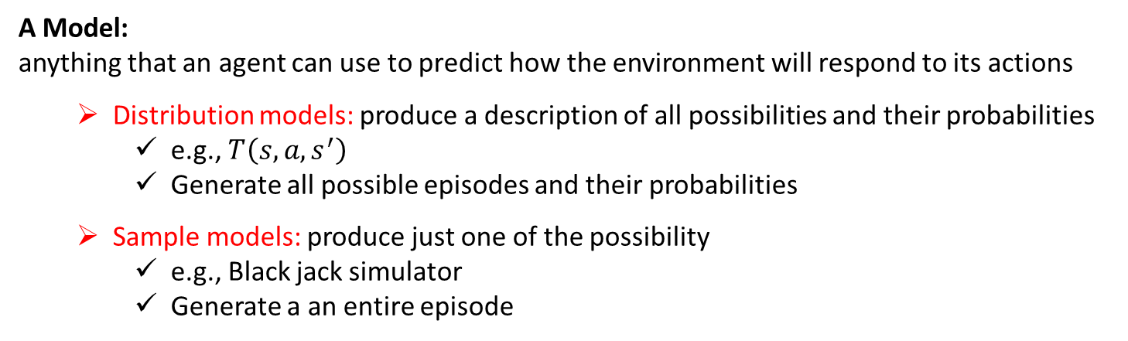
Planning and Learning
A Model:
anything that an agent can use to predict how the environment will respond to its actions
Distribution models: produce a description of all possibilities and their probabilities
e.g., $T\left(s,a,s^{′}\right)$
Generate all possible episodes and their probabilities
Sample models: produce just one of the possibility
e.g., Black jack simulator
Generate a an entire episode
Planning:
Refer to any computational process that takes a model as input and produces or imporves a policy for interacting with the modeled environment
State-space planning: search through the state space for an optimal policy
e.g., Q learning
Plan-space planning : Search through the space of plans
e.g., Route finding, Task ordering
Planning
Model
Policy

Slide 8
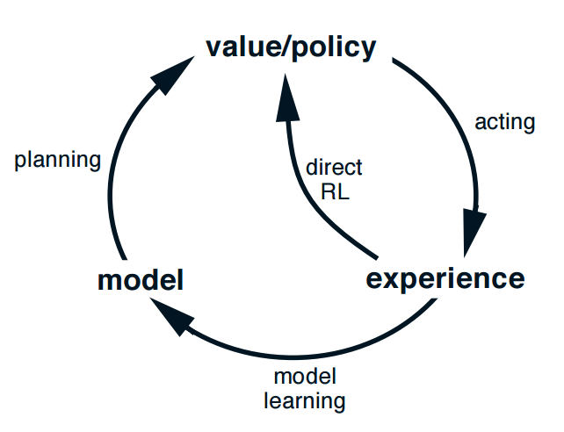
Integrating Planning, Acting, and Learning
A Planning agent conduct two tasks simultaneously using experience:
Model-learning: use experience to improve the model
(make it more accurately match the real environment)
Direct reinforcement learning : use experience to directly improve the value function and policy using RL techniques
model
simulated experience
backups
values
policy

Slide 9
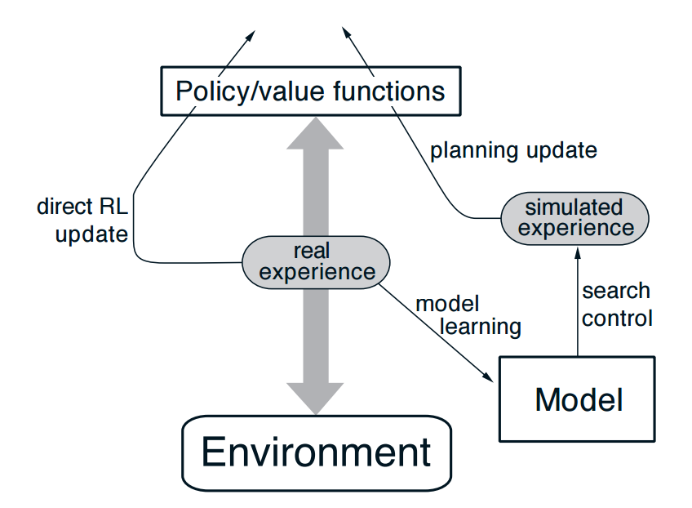
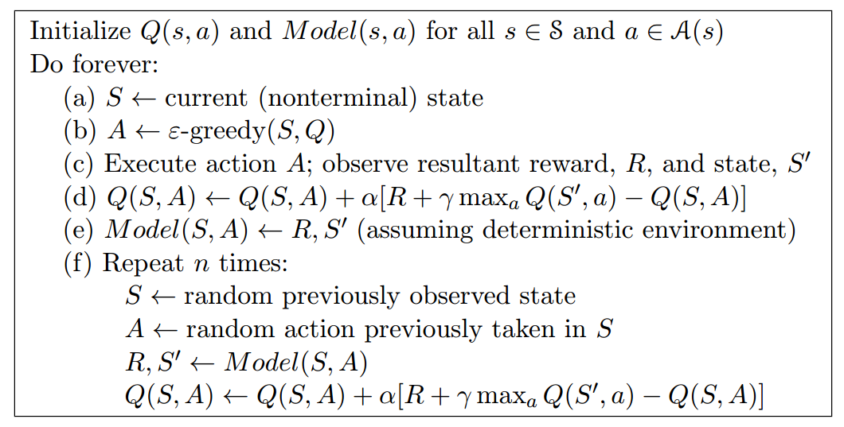
Dyna-Q algorithm

Slide 10
1. One step→ Multiple steps ahead (links to Monte Carlo)
2. Model-free→ Include the model of environment (links to Dynamic programming)
3. Tabular → Continuous space (links to supervised learning)
4. Single agent → Multiple Agents (links to Game theory: Stochastic Game)

Slide 11
Q-learning with function approximation
Q-learning (stochastic gradient update)
$$Q\left(s,a\right)←Q\left(s,a\right)+η\left[\left(r+γ\max_{a}{Q\left(s′,a\right)}\right)−Q\left(s,a\right)\right]$$
Problem:
Basic Q-Learning keeps a table of all q-values
We cannot possibly learn about every single state!
Too many states to visit them all in training
Too many states to hold the q-tables in memory
Doesn’t generalize to unseen states/actions
Solution:
Learn about some small number of training states from experience
Generalize that experience to new, similar situations
fundamental idea in machine learning

Slide 12
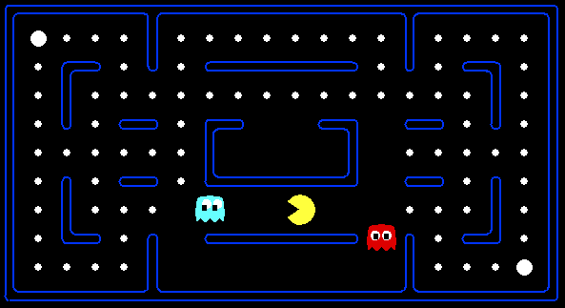



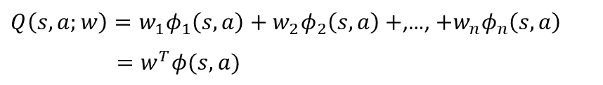
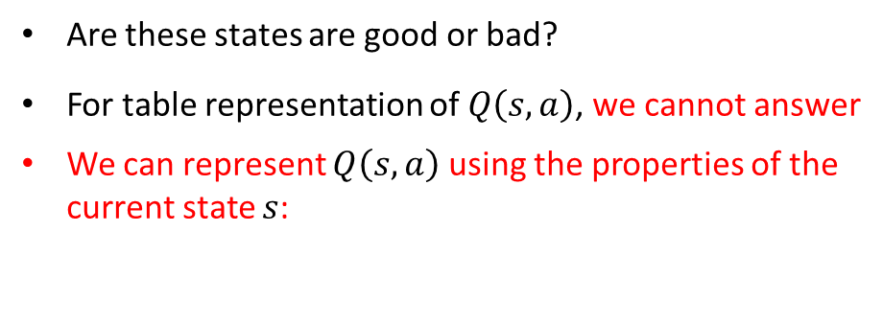
Q-learning with function approximation
Obtained experience:
This state is bad!
Complete new states
?
Are these states are good or bad?
For table representation of $Q\left(s,a\right)$, we cannot answer
We can represent $Q\left(s,a\right)$ using the properties of the current state $s$:
$Q\left(s, a;w\right)=w_{1}φ_{1}\left(s,a\right)+w_{2}φ_{2}\left(s,a\right)+$,…, $+w_{n}φ_{n}\left(s,a\right)$
$=w^{T}φ(s,a)$
$φ_{i}\left(s,a\right)$: distance to closet ghost, number of ghost, distance to foods

Slide 13
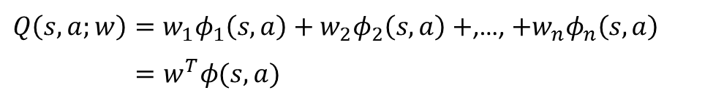

Q-learning with function approximation
Approximate $Q\left(s, a\right)$ as a function:
$Q\left(s, a;w\right)=w_{1}φ_{1}\left(s,a\right)+w_{2}φ_{2}\left(s,a\right)+$,…, $+w_{n}φ_{n}\left(s,a\right)$
$=w^{T}φ(s,a)$
$w$ : weight vector$φ(s,a)$ : features vector
Features, $φ\left(s,a\right)=\left\{φ_{1}\left(s,a\right),…,φ_{n}\left(s,a\right)\right\}$, are supposed to be properties of the state-action $(s,a)$ pair that are indicative of the quality of taking action $a$ and state $s$

Slide 14
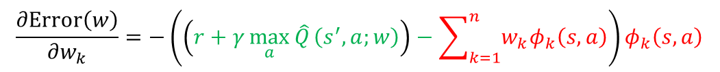
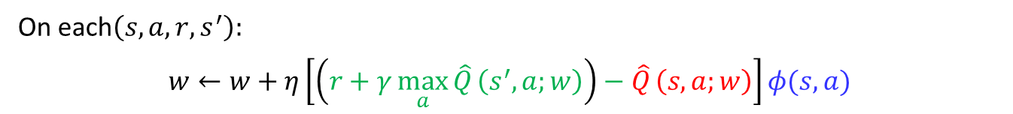
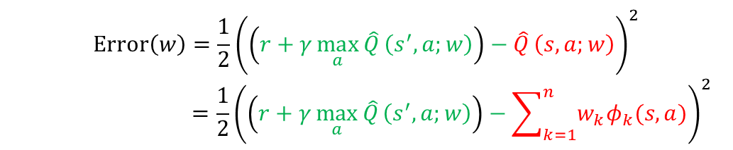
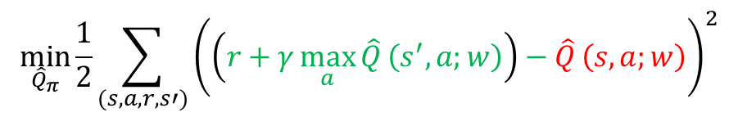
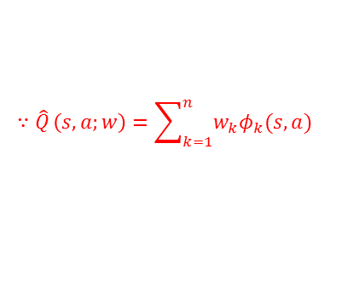
Q-learning with function approximation
Algorithm : Q-learning with function approximation
On each$\left(s,a,r,s^{′}\right):$
$$w←w+η\left[\left(r+γ\max_{a}{{\hat{Q}}_{ }\left(s^{′},a;w\right)}\right)−{\hat{Q}}_{ }\left(s,a;w\right)\right]φ(s,a)$$
Target
Estimate
This is equivalent to find the weight $w$ that maximizes the following objective function
$$\min_{{\hat{Q}}_{π}}{\frac{1}{2}\sum_{(s,a,r,s′)}^{ }{{\left(\left(r+γ\max_{a}{{\hat{Q}}_{ }\left(s^{′},a;w\right)}\right)−{\hat{Q}}_{ }\left(s,a;w\right)\right)}^{2}}}$$
Target
Estimate
For a single transition $\left(s,a,r,s^{′}\right),$ the error can be expressed as:
$$Error\left(w\right)=\frac{1}{2}{\left(\left(r+γ\max_{a}{{\hat{Q}}_{ }\left(s^{′},a;w\right)}\right)−{\hat{Q}}_{ }\left(s,a;w\right)\right)}^{2}$$
$$=\frac{1}{2}{\left(\left(r+γ\max_{a}{{\hat{Q}}_{ }\left(s^{′},a;w\right)}\right)−\sum_{k=1}^{n}{w_{k}φ_{k}(s,a)}\right)}^{2}$$
$$∵{\hat{Q}}_{ }\left(s,a;w\right)=\sum_{k=1}^{n}{w_{k}φ_{k}(s,a)}$$
$$\frac{∂Error\left(w\right)}{∂w_{k}}=−\left(\left(r+γ\max_{a}{{\hat{Q}}_{ }\left(s^{′},a;w\right)}\right)−\sum_{k=1}^{n}{w_{k}φ_{k}\left(s,a\right)}\right)φ_{k}\left(s,a\right)$$
$$w_{k}←w_{k}+η\left[\left(r+γ\max_{a}{{\hat{Q}}_{ }\left(s^{′},a;w\right)}\right)−{\hat{Q}}_{ }\left(s,a;w\right)\right]φ(s,a)$$

Slide 15
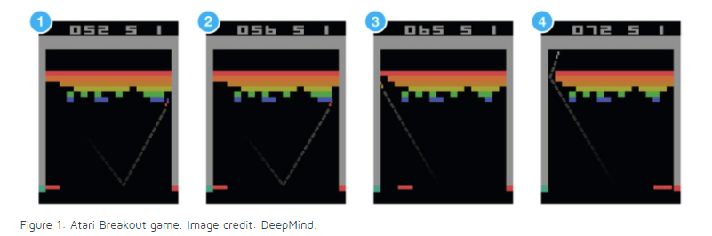
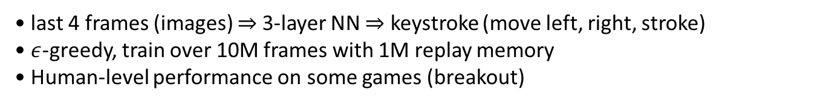
Deep Reinforcement Learning
Use a neural network for estimating $Q\left(s,a\right)$
Playing Atari [Google DeepMind, 2013]:
$$a^{∗}=π\left(s= \right)$$
move left
move right
stroke
• last 4 frames (images) ⇒ 3-layer NN ⇒ keystroke (move left, right, stroke)
• $ε$-greedy, train over 10M frames with 1M replay memory
• Human-level performance on some games (breakout)
https://www.nervanasys.com/demystifying-deep-reinforcement-learning/

Slide 16
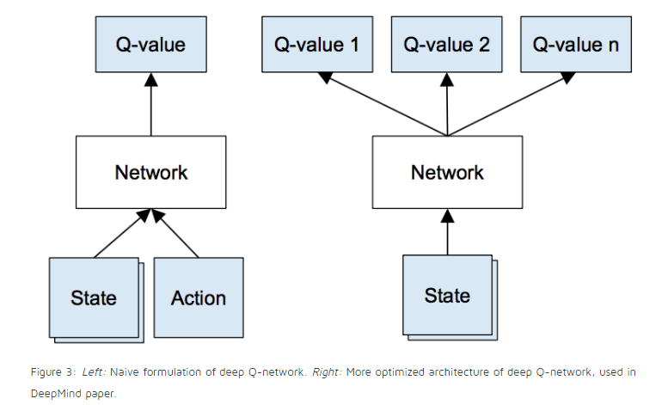





Q-Learning with Neural Network
Screen size : $84×84$ and convert to grayscale with $256$ gray levels
State size = ${256}^{84×84×4}≈{10}^{67970}$ more than the number of atoms in the known universe
$$Q\left(s,a\right)=$$
$${10}^{67970}$$
Need to represent this large Q table using a function approximation (Deep learning)
Need to estimate Q-values for states that have never been seen before (generalization
$$a_{1}$$
$$a_{2}$$
$$a_{n}$$

Slide 17
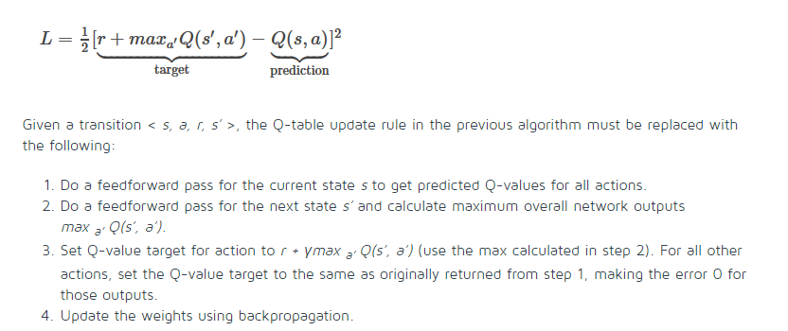
Q-Learning with Neural Network

Slide 18
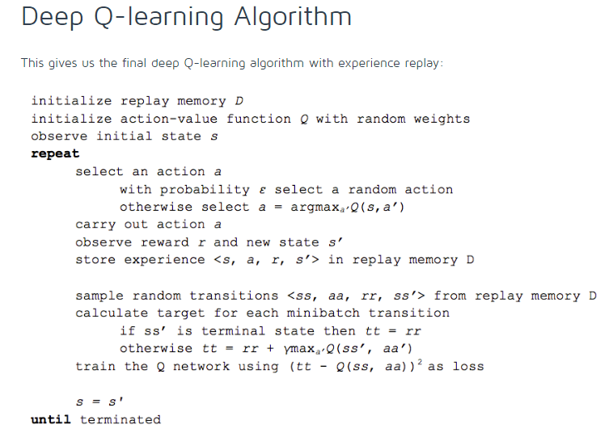

Slide 19
1. One step→ Multiple steps ahead (links to Monte Carlo)
2. Model-free→ Include the model of environment (links to Dynamic programming)
3. Tabular → Continuous space (links to supervised learning)
4. Single agent → Multiple Agents (links to Game theory: Stochastic Game)

Slide 20
Normal Form Game
Prisoner’s Dilemma
Player 2
C
D
(-1, -1)
(-4,0)
C
Player 1
(0,-4)
(-3,3)
D
Nash Equilibrium Solution Concept

Slide 21
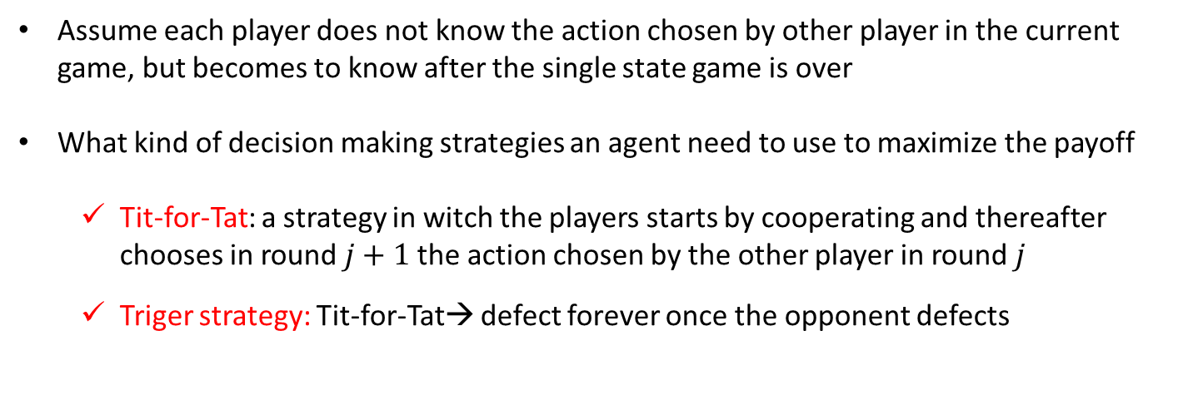
Repeated Game
What happens when a simple normal-from game is repeated infinitely?
C
D
C
D
C
D
C
D
(-1, -1)
(-4,0)
(-1, -1)
(-4,0)
(-1, -1)
(-4,0)
(-1, -1)
(-4,0)
C
C
C
…
C
(0,-4)
(-3,3)
(0,-4)
(-3,3)
(0,-4)
(-3,3)
(0,-4)
(-3,3)
D
D
D
D
Assume each player does not know the action chosen by other player in the current game, but becomes to know after the single state game is over
What kind of decision making strategies an agent need to use to maximize the payoff
Tit-for-Tat: a strategy in witch the players starts by cooperating and thereafter chooses in round $j+1$the action chosen by the other player in round $j$
Triger strategy: Tit-for-Tat→ defect forever once the opponent defects

Slide 22
Stochastic Games
With Models
Stateless
State
Single Agent
Optimization
Markov Decision Process
Multiple Agents
Repeated Game
Stochastic Game
NDP:RL::Stochastic Game: Multi-Agent RL
Data-driven approaches
Without Models
Stateless
State
Single Agent
Model-free Optimization
Reinforcement Learning
Multiple Agents
Learning in Repeated Game
Multi-Agents
Reinforcement Learning

Slide 23
Stochastic Games
A stochastic game is a generalization of repeated games
agents repeatedly play games from a set of normal-form games
the game played at any iteration depends on the previous game played and on the actions taken by all agents in that game
A stochastic game is a generalized Markov decision process
there are multiple players
one reward function for each agent
the state transition function and reward functions depend on the action choices of all of the players

Slide 24
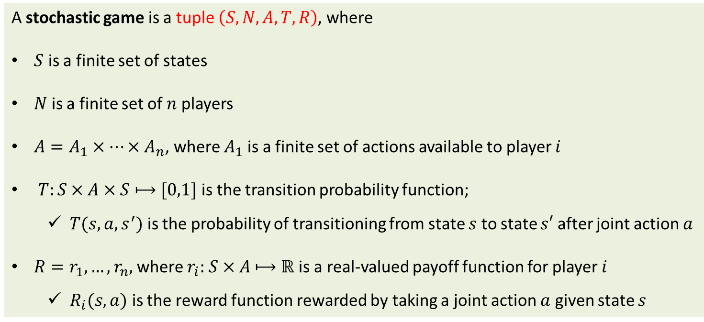
Stochastic Games
A stochastic game is a tuple $\left(S,N,A,T,R\right)$, where
$S$ is a finite set of states
$N$ is a finite set of $n$ players
$A=A_{1}×⋯×A_{n}$, where $A_{1}$ is a finite set of actions available to player $i$
$T:S$ $×A×S⟼[0,1]$ is the transition probability function;
$T(s,a,s^{′})$ is the probability of transitioning from state $s$ to state $s′$ after joint action $a$
$R=r_{1},…,r_{n},$ where $r_{i}:$ $S$ $×A$ $⟼ℝ$ is a real-valued payoff function for player $i$
$R_{i}(s,a)$ is the reward function rewarded by taking a joint action $a$ given state $s$
This assumes strategy space is the same in all games otherwise just more notation
Again we can have average or discounted payoffs.
Interesting special cases:
- zero-sum stochastic game
- single-controller stochastic game transitions (but not payoffs) depend on only one agent

Slide 25
Stochastic (Markov) Games
$
A
B
First to reach goal gets $100
If both reaches the money at the same time, both win
Semi wall (50% go through)
Cannot occupy the same grid
Coin flip if collide

Slide 26
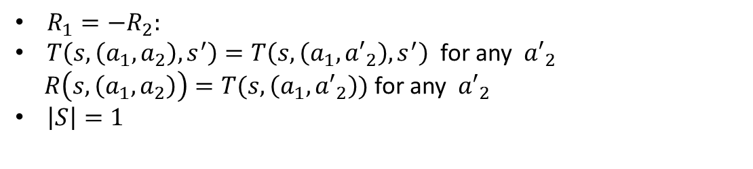
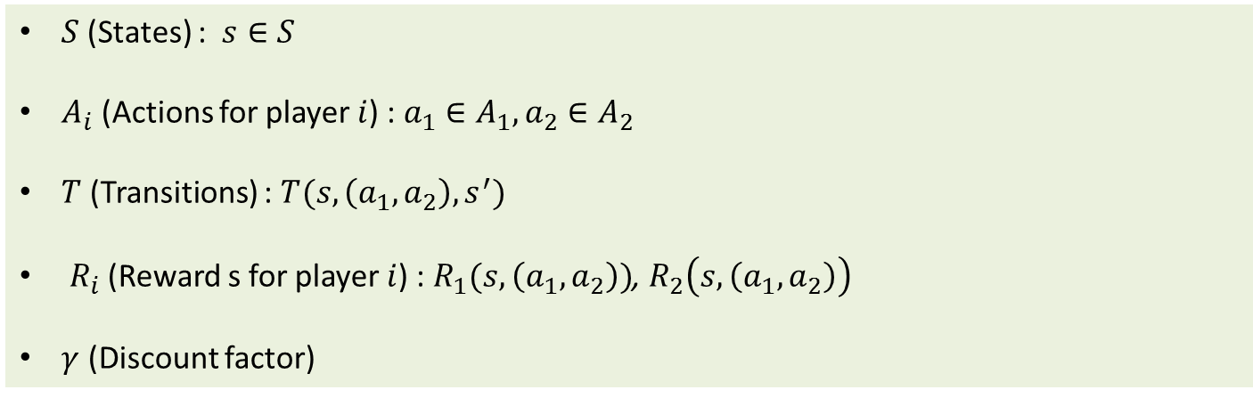
Stochastic (Markov) Games
2 players stochastic game
$S$(States) : $s∈S$
$A_{i}$ (Actions for player $i$) : $a_{1}∈A_{1},a_{2}∈A_{2}$
$T$ (Transitions) : $T(s, \left(a_{1}, a_{2}\right), s^{′})$
$R_{i}$ (Reward s for player $i$) : $R_{1}(s, \left(a_{1}, a_{2}\right))$, $R_{2}\left(s, \left(a_{1}, a_{2}\right)\right)$
$γ$ (Discount factor)
Narrowing down the definition
$R_{1}=−R_{2}:$
$T\left(s, \left(a_{1}, a_{2}\right), s^{′}\right)=T\left(s, \left(a_{1}, {a′}_{2}\right), s^{′}\right)$ for any ${a′}_{2}$
$R\left(s, \left(a_{1}, a_{2}\right)\right)=T(s, \left(a_{1}, {a′}_{2}\right))$ for any ${a′}_{2}$
$\left|S\right|=1$
Zero-sum Stochastic Game
MDP
Repeated Game

Slide 27
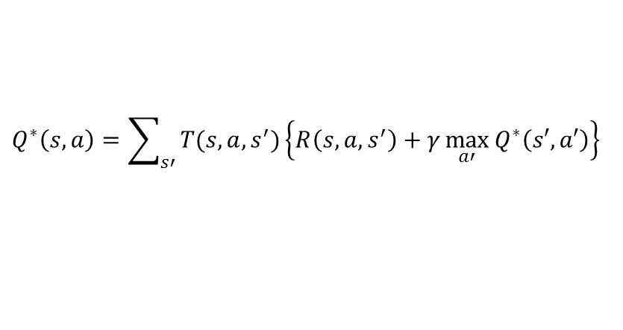
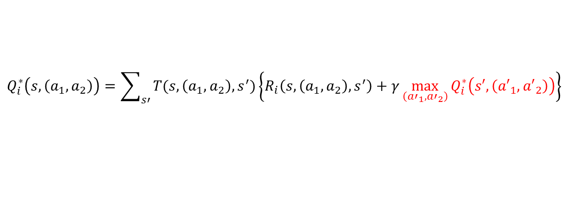
Stochastic (Markov) Games
2 players stochastic game
Zero-sum Stochastic Game
MDP← Q-learning
Can we employ Q-learning approach to Stochastic Game?
$$Q^{∗}\left(s,a\right)=\sum_{s′}{T(s,a,s^{′})\left\{R\left(s,a,s^{′}\right)+γ\max_{a′}{Q^{∗}\left(s′,a′\right)}\right\}}$$
$$Q_{i}^{∗}\left(s,\left(a_{1},a_{2}\right)\right)=\sum_{s′}{T(s,\left(a_{1},a_{2}\right),s^{′})\left\{R_{i}\left(s,\left(a_{1},a_{2}\right),s^{′}\right)+γ\max_{\left({a′}_{1},{a′}_{2}\right)}{Q_{i}^{∗}\left(s′,\left({a′}_{1},{a′}_{2}\right)\right)}\right\}}$$
Is this correct?
This is not correct
because it assumes that joint actions will benefit the agent $i$ the most.

Slide 28
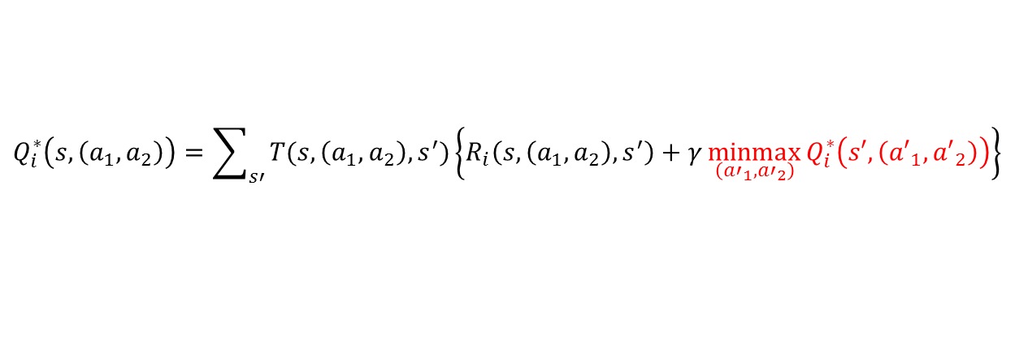
Stochastic (Markov) Games
2 players stochastic game
Zero-sum Stochastic Game
MDP← Q-learning
Can we employ Q-learning approach to Stochastic Game?
$$Q^{∗}\left(s,a\right)=\sum_{s′}{T(s,a,s^{′})\left\{R\left(s,a,s^{′}\right)+γ\max_{a′}{Q^{∗}\left(s′,a′\right)}\right\}}$$
$$Q_{i}^{∗}\left(s,\left(a_{1},a_{2}\right)\right)=\sum_{s′}{T(s,\left(a_{1},a_{2}\right),s^{′})\left\{R_{i}\left(s,\left(a_{1},a_{2}\right),s^{′}\right)+γ\max_{\left({a′}_{1},{a′}_{2}\right)}{Q_{i}^{∗}\left(s′,\left({a′}_{1},{a′}_{2}\right)\right)}\right\}}$$
$$Q_{i}^{∗}\left(s,\left(a_{1},a_{2}\right)\right)=\sum_{s′}{T(s,\left(a_{1},a_{2}\right),s^{′})\left\{R_{i}\left(s,\left(a_{1},a_{2}\right),s^{′}\right)+γ\underset{\left({a′}_{1},{a′}_{2}\right)}{minmax}{Q_{i}^{∗}\left(s′,\left({a′}_{1},{a′}_{2}\right)\right)}\right\}}$$

Slide 29


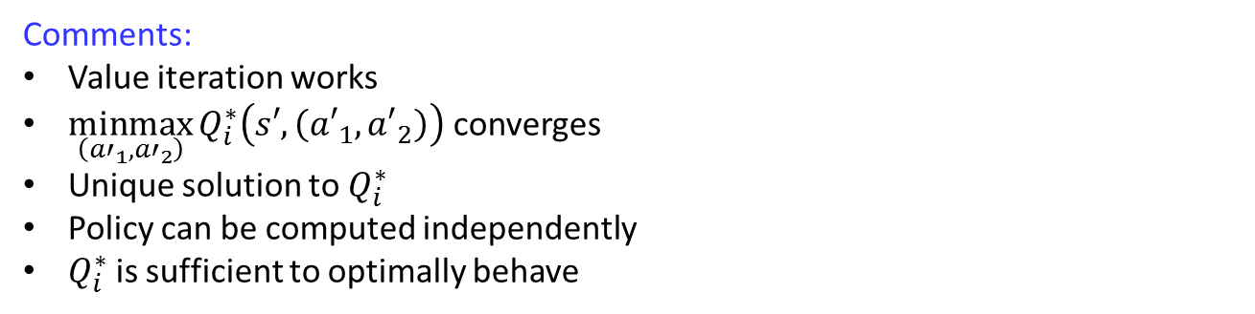
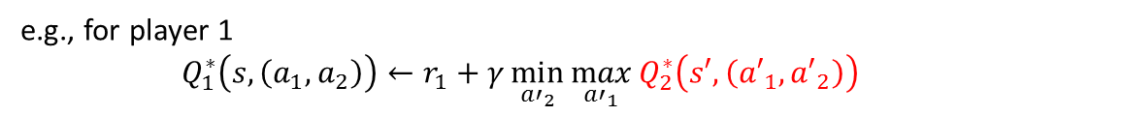
Stochastic (Markov) Games
2 players stochastic game
Zero-sum Stochastic Game
$$Q_{i}^{∗}\left(s,\left(a_{1},a_{2}\right)\right)=\sum_{s′}{T(s,\left(a_{1},a_{2}\right),s^{′})\left\{R_{i}\left(s,\left(a_{1},a_{2}\right),s^{′}\right)+γ\underset{\left({a′}_{1},{a′}_{2}\right)}{minmax}{Q_{i}^{∗}\left(s′,\left({a′}_{1},{a′}_{2}\right)\right)}\right\}}$$
$$Q_{i}^{∗}\left(s,\left(a_{1},a_{2}\right)\right)←r_{i}+γ\underset{\left({a′}_{1},{a′}_{2}\right)}{minmax}{Q_{i}^{∗}\left(s′,\left({a′}_{1},{a′}_{2}\right)\right)}$$
e.g., for player 1
$Q_{1}^{∗}\left(s,\left(a_{1},a_{2}\right)\right)←r_{1}+γ\min_{{a′}_{2}}{\max_{{a′}_{1}}{Q_{2}^{∗}\left(s′,\left({a′}_{1},{a′}_{2}\right)\right)}}$
Comments:
Value iteration works
$\underset{\left({a′}_{1},{a′}_{2}\right)}{minmax}{Q_{i}^{∗}\left(s′,\left({a′}_{1},{a′}_{2}\right)\right)}$ converges
Unique solution to $Q_{i}^{∗}$
Policy can be computed independently
$Q_{i}^{∗}$ is sufficient to optimally behave

Slide 30
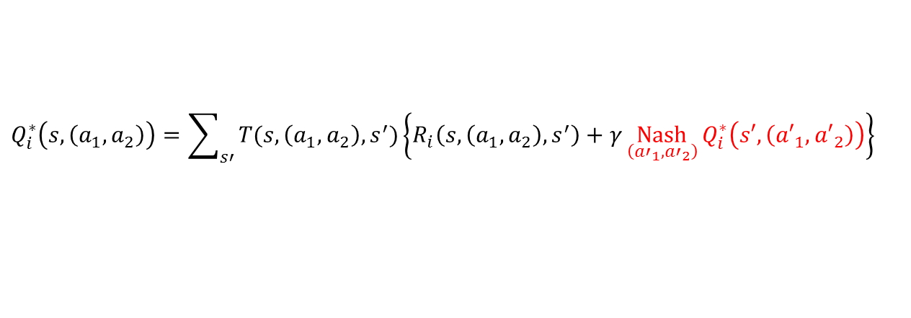

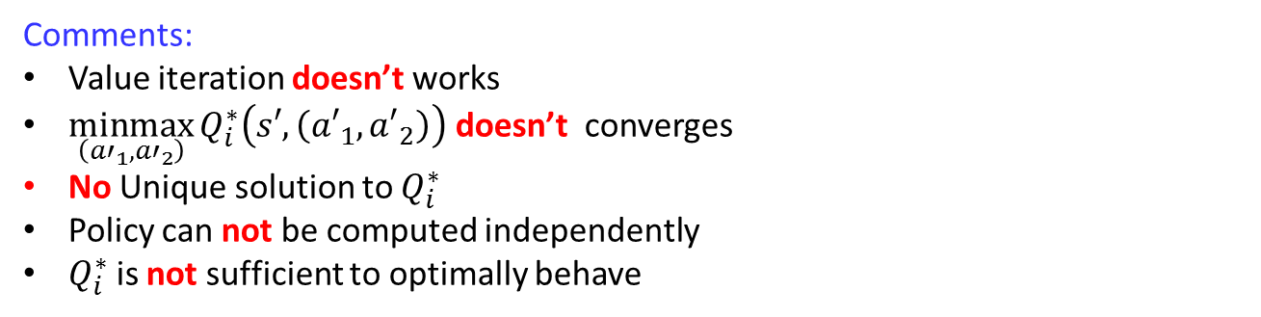

Stochastic (Markov) Games
2 players stochastic game
General-sum Stochastic Game
$$Q_{i}^{∗}\left(s,\left(a_{1},a_{2}\right)\right)=\sum_{s′}{T(s,\left(a_{1},a_{2}\right),s^{′})\left\{R_{i}\left(s,\left(a_{1},a_{2}\right),s^{′}\right)+γ\underset{\left({a′}_{1},{a′}_{2}\right)}{minmax}{Q_{i}^{∗}\left(s′,\left({a′}_{1},{a′}_{2}\right)\right)}\right\}}$$
$$Q_{i}^{∗}\left(s,\left(a_{1},a_{2}\right)\right)=\sum_{s′}{T(s,\left(a_{1},a_{2}\right),s^{′})\left\{R_{i}\left(s,\left(a_{1},a_{2}\right),s^{′}\right)+γ\underset{\left({a′}_{1},{a′}_{2}\right)}{Nash}{Q_{i}^{∗}\left(s′,\left({a′}_{1},{a′}_{2}\right)\right)}\right\}}$$
$$Q_{i}^{∗}\left(s,\left(a_{1},a_{2}\right)\right)←r_{i}+γ\underset{\left({a′}_{1},{a′}_{2}\right)}{Nash}{Q_{i}^{∗}\left(s′,\left({a′}_{1},{a′}_{2}\right)\right)}$$
Comments:
Value iteration doesn’t works
$\underset{\left({a′}_{1},{a′}_{2}\right)}{minmax}{Q_{i}^{∗}\left(s′,\left({a′}_{1},{a′}_{2}\right)\right)}$ doesn’t converges
No Unique solution to $Q_{i}^{∗}$
Policy can not be computed independently
$Q_{i}^{∗}$ is not sufficient to optimally behave

Slide 31
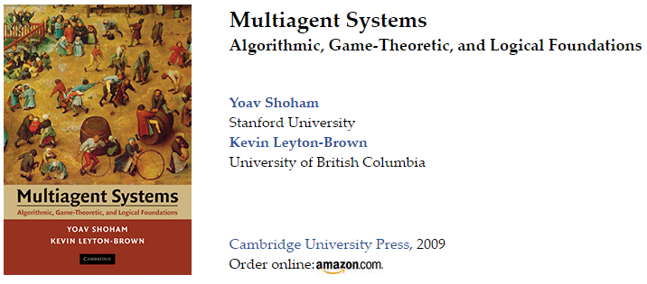
IE 881 &IE 481 : Engineering Applications to Game Theory
2017 Spring

